Slide 1
JULIE & KENNETH
MAY 30TH, 2026
130-150 GUESTS
LE PRÉ CATELAN
WEDDING MOOD BOARD

Slide 2
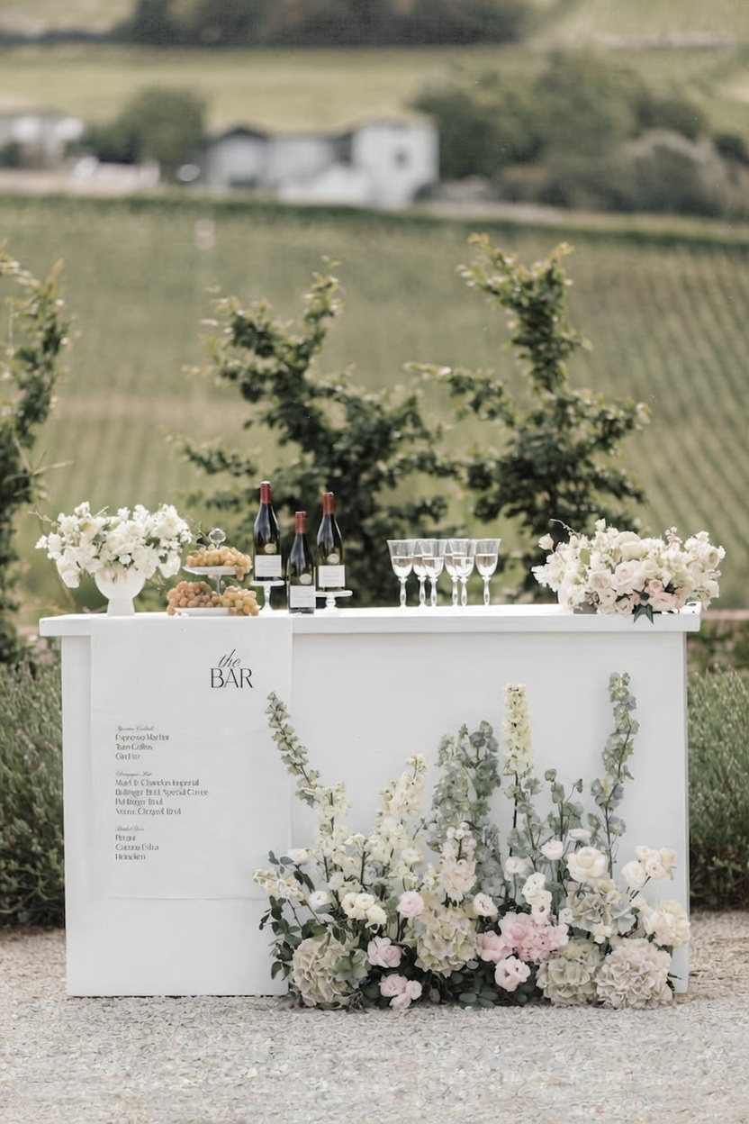
BARS SIGN
A bespoke banner will be designed and printed, showcasing the selected beverages
The décor will echo the reference imagery, styled in harmony with the color palette detailed on slide #2

Slide 3
SIGNS
Audrey’s note: To create an harmony between the differents signage I recommend using the same font style and color (as much as possible) – TBC with Julie a design proof will be sent.

Slide 4
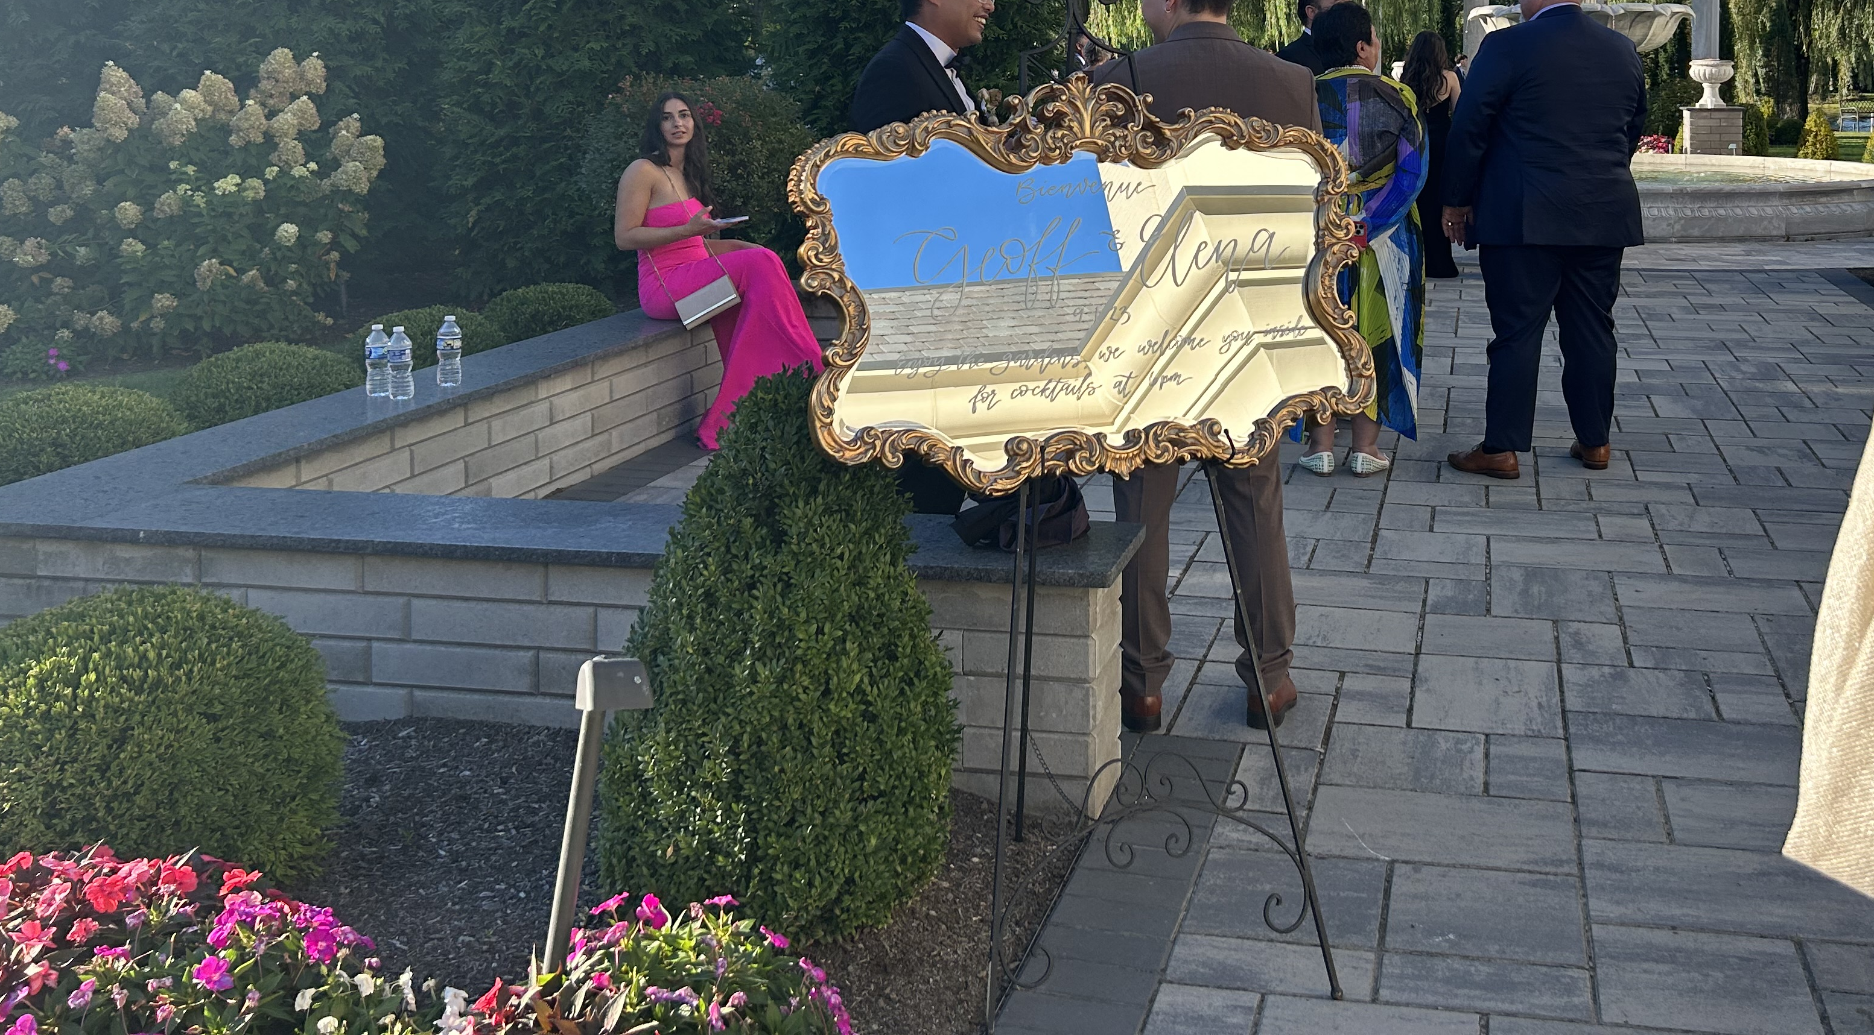
Welcome Sign & Décor
A Baroque-style gold mirror will showcase the bride and groom’s names in luminous gold script, paired with the wedding date in refined dark brown typography, exuding sophistication and timeless elegance
The gold frame will be a distinct variation from the reference image, providing a bespoke and sophisticated touch while preserving the overall elegance of the design

Slide 5
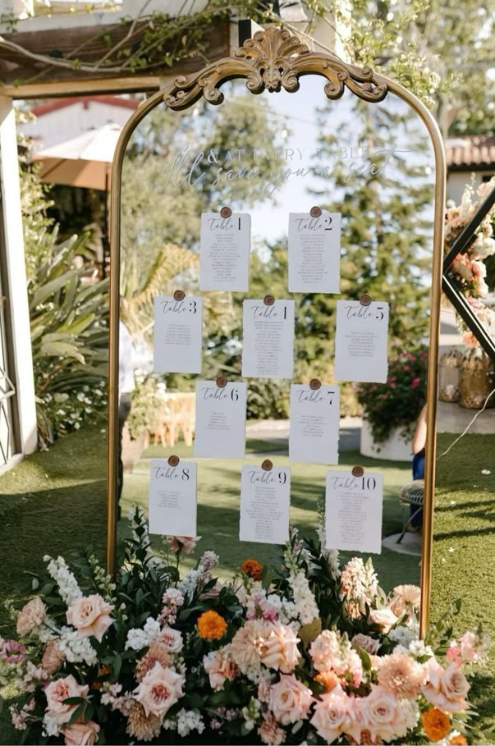
Seating Chart
A large rectangular mirror with a gold frame will display the seating chart, featuring dark brown script typography printed on white paper and elegantly mounted with gold wax seals, presenting each table number and guest name
A large-sized floral arrangement will be displayed at the base of the seating chart, with décor echoing the reference imagery and styled in harmony with the color palette detailed on slide #2

Slide 6
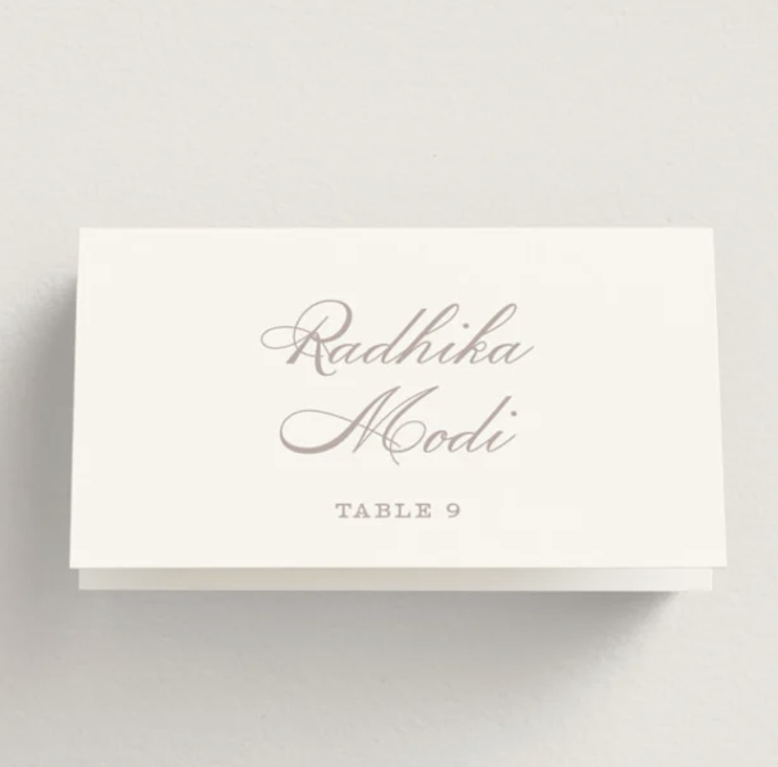
Place Cards
Audrey’s Note:
Please note that place cards are required by the catering staff regardless of round or rectangular tables. For weddings with more than 100 guests, place cards must be placed on each table with assigned seating, showing each guest’s full name, table number, and a meal icon/allergy note to guide the staff.

Slide 7
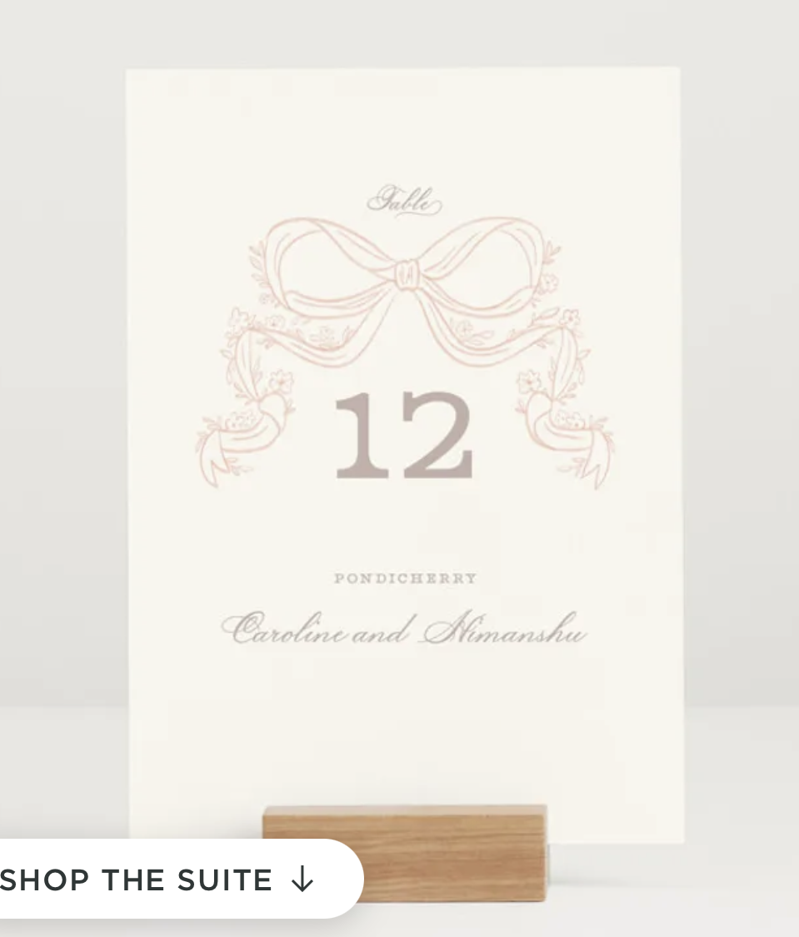
Table numbers
A refined rectangular design, printed on warm white paper and adorned with dark brown script typography and a subtle dusty pink printed knot, will be elegantly displayed on a wooden holder

Slide 8
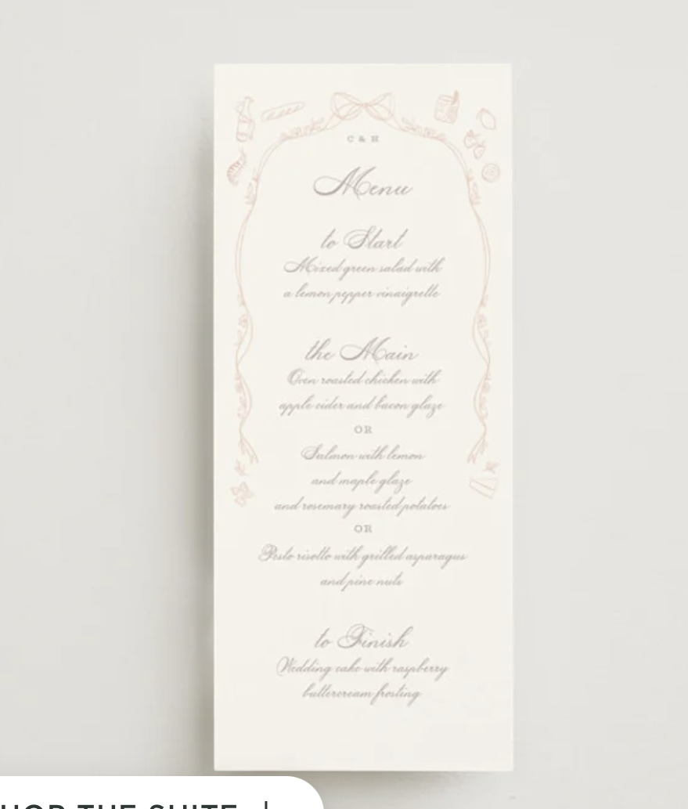
Menus
A large rectangular design, crafted from warm white, smooth, thick matte paper and adorned with elegant dark script typography and subtle dusty pink detailing, creating a refined and harmonious aesthetic

Slide 9
NOTES POUR LE DESIGNER / IMPRIMEUR:
1 BAR SIGN
1 WELCOME SIGN
1 SEATING CHART (15 CARTES A “COLLER” SUR MIRROIR QUE JE FOURNIRAI)
150 PLACE CARDS
15 NUMEROS DE TABLES
150 MENUS

